Slide 1


Slide 2



CONCEPTS
What Is Transactional Analysis?
Notes:
So, what exactly is TA? How does it affect the way we think and behave? What can we do to control the states we are in? And what effect can that have in our lives?

Slide 3
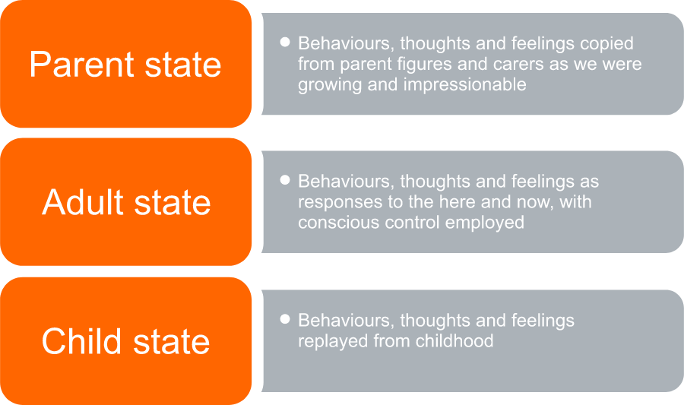
CONCEPTS
Transactional Analysis Ego States
Notes:
These life scripts have a profound effect on how we think, feel, and behave. We are conditioned to respond in a certain way, based on the results we have achieved with that type of behaviour before.
If someone is ‘conflict-averse’, it may be due to the circumstances they experienced while growing up as a child. If someone has a short-fuse and reacts angrily to the most innocuous of situations, there’s a possibility he or she was conditioned that way from experiences at an early age.
Hence, the development of the ‘script’ by which we decide to behave.
Changing this script is the aim of transactional analysis psychotherapy. Societal or experience scripting can be replaced with co-operative, collaborative behaviour through discussions on the analysis of TA.
The three ego states or ways of being can be likened to three phases of life we experience
Blocks
How we respond to situations and stimulate the other’s response in a conversation can depend on several areas:

Slide 4
CONCEPTS
How did we respond to similar influences when we were young?
What past traumas did we endure?
How is the other treating us?
What messages are our brains interpreting and what meanings are we getting?
How important is the relationship I have with this person?
Notes:
These and many other questions can determine firstly how we respond to the transaction we are having, and secondly how we will be stimulated to carry on the transaction.
That’s why it is so popular in the courses that we run. Leaders can appreciate why they behave in a certain way and can then take that on to how their people and teams behave the way that they do.

Slide 5

CONCEPTS
The Child State
Notes:
Transactional analysis discussed two components of the child state: adapted and free child.
This ego state builds on the reinforcements we were given when a child.

Slide 6
CONCEPTS
Were you given praise often?
Did your parents admonish you for certain behaviours?
Was your childhood filled with happy memories or negative experiences?
Notes:
Depending on how you were brought up, your experiences will still have effects on our transactions today.
The adapted child tries to please others and likes to be liked, so they act in accordance with others’ wishes. They could come across as submissive or timid, allowing others to control their feelings, sometimes without standing up for themselves.
The free child state can be seen as a spontaneous nature, intelligent, free-flowing, innovative and creative in their thinking. This could be part of the conditioning where the child was allowed to be free to express their ideas and had more freedom to adapt to various situations without being told to ‘be quiet’ or ‘sit down and shut up’.
There are, of course, different levels of each of these two components, so it would be incorrect to say a person is one or the other when they paly the child’s role in a transaction.
One way to think of a child’s response is to whom are they interacting in this way? If to a ‘parent’ ego state, you may see the person not wanting to disagree with that other person, just accepting orders to keep the peace. Or they may be flippant and joke around, covering up for some inadequacy seen by the parent model.

Slide 7

CONCEPTS
The Parent State
Notes:
The parent is an ego state reflected on how the person’s parent figures brought them up. If a stronger parent figure was a grandparent or teacher, that may have had a bigger effect on how the person feels an adult needs to respond to situations.
Again, there are two components to an adult state: Critical/controlling, and nurturing.
Eric Berne believed that the biggest contribution to how we view the parent state was decided in the first few years of life. One way of looking at a parent state is concerning the judgements we have of others and of situations. Our rules and standards often come from these parental figures. How a person thinks someone else should behave often comes from the examples placed on us by parental figures.
A critical parent state may well judge others by what they ‘should’ or shouldn’t’ do. Their rules are their rules, and everyone should abide by them. If they don’t, then they are judges as wrong, or inconsistent, or selfish, or similar. Feedback could be delivered in an aggressive, passive-aggressive or harsh way.
A nurturing parent ego state would drive a person to be more understanding and softer in their approach. They would see a situation without judging, attempting to be more curious as to why a person would say or do something. A nurturing disposition may be helpful in trying to calm situations down or when establishing closer relationships.

Slide 8
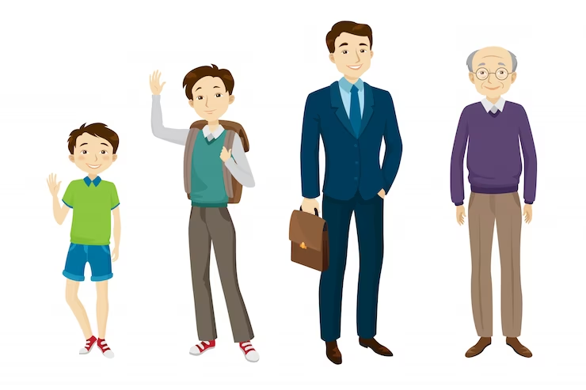
CONCEPTS
The Adult State
Notes:
This only has one component or division attached to it. Whereas the child and parent state may be driven by past experiences and conditioning, the adult state considers the here and now situation.
The adult state is more open to discussion, more curious as to why people feel the way they do, has more time for sifting through data and information, is more respectful of others’ opinions, is willing to collaborate and compromise, and enjoys more close and healthy relationships.
We often find the adult state is employed when making decisions that will affect others or solving problems in a working environment.

Slide 9
CONCEPTS
How the states interact
Notes:
Depending on what state we choose to adopt, a transaction with others could thrive or whither away to nothing. It could make a difference between building a strong relationship with another or causing a deep division between people.
Eric Berne recognised that we experience positive and negative interactions all through our lives and referred to these as ‘strokes’. A positive stroke makes us feel good about ourselves, whereas a negative interaction causes the opposite effect.
How each person you interact with gives and receives these strokes can make a big difference in how they perceive each other.
Which of these ego states do you believe achieves the best results in most situations?
TA concludes that adult to adult communication is the one that elicits the most helpful results.

Slide 10
CONCEPTS
Here, we show how the ego states interact:
Complementary Transaction
Ulterior Transaction
Crossed Transaction

Slide 11
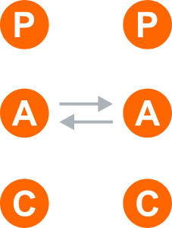
CONCEPTS
Complementary Transactions
Notes:
This can be assumed when the ego states of the people in conversation are parallel to each other, as in the drawing above.
You can think of this as the sender being in one state and the receiver being in the same state, complementing to the ego states instead of being challenged by it.
Naturally, the best state to be in for this, is the adult-adult state, as the two people work in harmony with each other so they can find common areas of agreement rather than conflict.
However, if both are in a complementary but child-child state, you may not find decisions being made, or ending up simply in a griping or blaming session.
Similarly, if both are in a parent state, you may find both of them wanting their own way and still not able to find solutions to their issues. Hence, an adult-adult complementary state is the best one to find results.

Slide 12
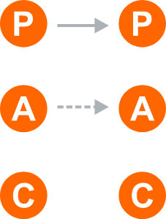
CONCEPTS
Ulterior Transactions
Notes:
You’ll have heard of ‘ulterior motives’ or ‘hidden agendas’. This is where a person’s behaviour or statements say one thing, while surreptitiously or subconsciously meaning something else.
This can be the essence of an ulterior transaction, where an underlying, subtle message from one state could be interpreted as another state by the other person.
For example, a boss may say ‘I have confidence that you can do this project, though it will need a lot of due diligence and checking to get it done’
The receiver may see this as a challenge and their rebellious child ego may come to the fore, saying something like ‘I’ll show him that I can do it without all that checking, just you wait and see!”

Slide 13
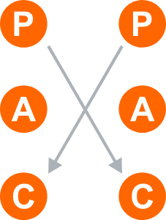
CONCEPTS
Crossed Transactions
Notes:
This is when the ego states don’t match each other and can cause conflict in one way or another.
A crossed transaction will require one or both parties to shift perspectives so the communication can carry on at a reasonable level.
An example might be where a customer has a very demeaning attitude to you, complaining that you should be their servant and get a move on, or they’ll take their business elsewhere. Their critical parent state can cause you to take an adapted child state, wanting to please the aggressive parent, not wanting to cause a scene, and bowing down to the authoritarian stance the customer is taking.
Crossed transactional responses can cause people to break relationships and develop a character response that does not contribute to good problem-solving, so watch out if your tendency is to mismatch at any of the TA levels.

Slide 14
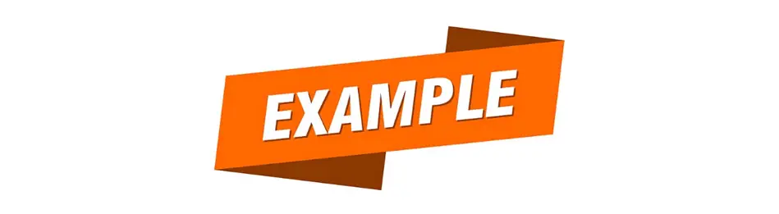
CONCEPTS
Transactional Analysis Examples and Exercises
Notes:
As we mentioned ‘life-scripts’, it’s important to note that practitioners in TA try to strengthen people’s adult ego states, as our conditioning can affect our behaviours at both the child and parent levels.
This can be termed ‘script-analysis’ as it analyses what script you have been living with for most of your life and how it can be brought to your attention when you are behaving in a less-than effective way.
The question as to when you should apply TA in your life is a simple one to answer.
Basically, it’s all the time!
Let’s say you have a meeting coming up where you know there may be some conflict in the air. You could play the parent role, by being quite dogmatic and authoritative in the ay you run it, so people recognise you have the final say, with no open discussion. Or you could just let people mouth off and lay into one another, hoping they will eventually find an answer themselves.
Neither the parent or child ego states would be best suited for that meeting situation, so you may choose to be the adult, allowing people to express their grievances, listening calmly and eloquently to all sides, before putting the emphasis on solving the problems and making effective decisions.

Slide 15
CONCEPTS
Transactional Analysis Exercise
Look at these examples and ascertain which of the three ego states they represent (parent, adult, child),
1) “I can’t get that project completed on time because marketing never gives us the info. They’re just a pain in the neck!”
Answer: This is an example of an adapted child ego state. The blame is being placed on someone else, without determining what changes need to be done to accomplish the end goals. Until the person shifts to a more problem-solving and less ‘blame-others’ state, this will be perpetuated for a long time.

Slide 16
CONCEPTS
Transactional Analysis Exercise
2) “Listen…Get Fred to drop that client now and get on with customers who will actually give us business for a change”
Answer: This aggressive stance is typical of a critical/controlling parent state. Sometimes it’s necessary to be dogmatic and tell people what to do, but if it’s the common way a manager speaks to his or her staff, you run the risk of losing collaboration and only achieving tasks through power and authority

Slide 17
CONCEPTS
Transactional Analysis Exercise
3) “We’ve been affected so badly by COVID that I don’t think we’ll ever be able to get back to how things were. No company could thrive under these conditions”
Answer: This adapted child state again looks at situations from the ‘helpless’ viewpoint. Straight after this expression, the person should start looking for solutions that are under their control, instead of playing the blame game for things they have no influence over

Slide 18
CONCEPTS
Transactional Analysis Exercise
4) “So, we’ve covered all the issues we’re facing now and are clear on what challenges we must deal with first. Let’s discuss who is going to take charge of the short-term issues and then come to a decision on how we ensure we don’t get into this situation again. Agreed?”
Answer: This comment shows a high degree of emotional intelligence and is looking for answers and solutions. It reflects an adult ego state.

Slide 19
CONCEPTS
Transactional Analysis Exercise
5) “What resources can I provide to help you become more successful? Can I get someone to assist you on the project, or do you just need more time?”
Answer: This shows a helpful and grateful attitude to what their staff member is trying to achieve. They are also looking for solutions, so they are approaching from a ‘nurturing parent’ state.

Slide 20







/ethnuscodemithra
Ethnus Codemithra
/ethnus
/code_mithra
THANK YOU
https://learn.codemithra.com/
codemithra@ethnus.com
+91 7815 095 095
+91 9019 921 340

Slide 21
CONCEPTS

Slide 22
CONCEPTS

Slide 23
CONCEPTS

Slide 24
CONCEPTS

Slide 25
CONCEPTS

Slide 26
CONCEPTS

Slide 27
CONCEPTS

Slide 28
CONCEPTS

Slide 29
CONCEPTS

Slide 30
CONCEPTS

Slide 31
CONCEPTS

